Slide 1
Markov Chains and Markov Processes
Shovan Bhowmik
Lecturer
Dept. of CSE(Baiust)

Slide 2
Introduction
Sometimes we are interested in how a random variable changes over time.
The study of how a random variable evolves over time includes stochastic processes.
An explanation of stochastic processes in particular, a type of stochastic process known as a Markov chain is included.
We will begin by defining the concept of stochastic process.

Slide 3
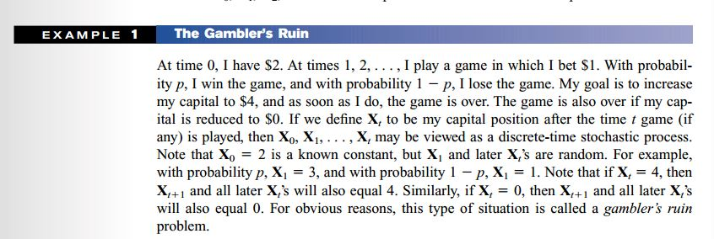
Stochastic Process
Many real world systems contain uncertainty and evolves over time.
The family of random variables {X_{t} | t ∈ T} forms a Stochastic Process.
A Discrete-time Stochastic Process is a sequence of random variables.
X₀, X₁ , X₂ . . . typically denoted by {X_{t}}.

Slide 4
Stochastic Process(Cont..)
A Continuous – Time Stochastic Process is simply the Stochastic process in which the state of the system can be viewed at any time, not just at discrete instants of time.
For example, the number of people in a supermarket t minutes after the store opens for business may be viewed as a continuous time stochastic process.

Slide 5
Stochastic Process(Cont..)
Values assumed by X_{t} are called States, set of all possible values of states constitute State Space (S).
If state space is
Discrete – Called Discrete-State Process or Chain
Continuous - Called Continuous-State Process
If index set T is
Discrete – Called Discrete-Time Process or Sequence
Continuous - Called Continuous-Time Process

Slide 6
Markov Chain
Markov Property: a stochastic process is said to have a markov property if probability distribution of future state depends only on present state and not on how the process arrived in that state.
Formally-The state of the system at time t+1 depends only on the state of the system at time t.
Let’s say the family of random variables {X_{tn}} = {x_{1,} x_{2,} ….., x_{n}} is said to be a markov process if it possesses the following property:

Slide 7
Markov Chain(Cont..)
A stochastic process {X_{t}} having Markov property is called Markov Process.
Markov chain -If the state space of a Markov process is discrete
Discrete-time Markov chain - If index set is also discrete
Stationary Assumption: For all states i, j and for all t, P(X_{t+1} = j |X_{t} = i) is independent of time (t).
So, P(X_{t+1} = j |X_{t} = i) = P(X₁ = j |X₀ = i) = p_{ij} ; where i,j = 0,1, …, s; t = 0,1, …,T
This means that if system is in state i, the probability that the system will transition to state j is p_{ij} no matter what the value of t is.

Slide 8
Markov Chain(Cont..)
p_{ij} = probability that the system will be in state j at time t+1 given that it is in state i at time t
Called one-step transition probability
Stationary Markov Chain – having stationary transition probabilities.
We generally represent transition probabilities of Markov Chain by a s × s Transition Probability Matrix P.

Slide 9
Markov Chain(Cont..)
It can also be represented by stochastic Finite state Machine.
Each entry in the transition matrix must be non-negative.
Hence all the values in the transition matrix are non-negative, the sum of all the values in each row must be equal to 1.
X₁
X₂
X₃
X₄
X₅

Slide 10
Examples of Markov Chain
Stochastic FSM: Transition Matrix:
Weather Example:
Raining today 40% rain tomorrow
60% no rain tomorrow
Not raining today 20% rain tomorrow
80% no rain tomorrow
State 1: Rain
State 2: No Rain
0.4
0.6
0.8
rain
no rain
0.2

Slide 11
Examples of Markov Chain(Cont..)
Gambler Example:
Gambler starts with $2
At each play we have one of the following:
• Gambler wins $1 with probability p
• Gambler looses $1 with probability 1-p
– Game ends when gambler goes broke, or gains a fortune of $4
(Both 0 and 4 are absorbing states)
p
p
p
1
1
0
1
3
4
1-p
1-p
Start (2$)
1-p

Slide 12
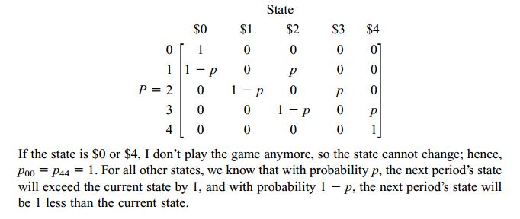
Examples of Markov Chain(Cont..)
Gambler Example:
p
p
p
1
1
0
1
3
4
1-p
1-p
Start (2$)
1-p
Transition Matrix:

Slide 13
Examples of Markov Chain(Cont..)
The Gardener Problem:
Soil Condition can be in three states. i) Good, ii) Fair, iii) Poor
Last year’s soil condition impacts current years productivity
The condition can either deteriotate or stay same but never improve
If soil condition is good(State 1), there is a 20% chance that it will not change next year, and 50% chance it will become fair(State 2) and 30% chance of getting poor(State 3)
If soil condition is fair(State 2), there is a 50% chance that it will remain fair next year, and 50% chance it will become poor(State 3)
The poor condition of this year can lead to an equal condition next year

Slide 14
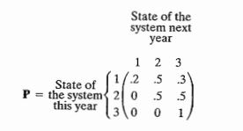
Examples of Markov Chain(Cont..)
The Gardener Problem:
So what will be the FSM and Transition Matrix??
Try yourself first.
FSM: Transition Matrix:
0.2
0.5
0.5
1.0
0.5
Good
Fair
Poor
0.3

Slide 15
Examples of Markov Chain(Cont..)
Coke vs Cola Example:
FSM: Transition Matrix:
Given that a person’s last cola purchase was Coke, there is a 90% chance that his next cola purchase will also be Coke.
If a person’s last cola purchase was Pepsi, there is an 80% chance that his next cola purchase will also be Pepsi.
0.9
0.1
0.8
coke
pepsi
0.2

Slide 16
Transforming a Process to a Markov Chain
Whether or not it rains today depends on previous weather conditions through last two days.
If it rained for past two days, it will rain tomorrow with prob. 0.7
If it rained today but not yesterday, it will rain tomorrow with prob. 0.5
If it rained yesterday but not today, it will rain tomorrow with prob. 0.4
If it has not rained for past two days, it will rain tomorrow with prob. 0.2
Let the state at time n – depend only on a single day
Not a Markov chain
Convert – n saying that it depend on both day

Slide 17
Transforming a Process to a Markov Chain(Cont..)
State 0 - If it rained today and yesterday (RR)
State 1 - If it rained today but not yesterday (NR)
State 2 - If it rained yesterday but not today (RN)
State 3 - If it did not rained either today or yesterday (NN)
Today, Tomorrow
Yesterday, Today
RR
NR
RN
NN
RR NR RN NN

Slide 18
Characteristics of a Markov Chain
Next state depends on previous state only, therefore, it is sufficient to know
the distribution of its initial state X₀
- initial distribution P₀ – pmf of X₀
the mechanism of transitions from one state to another.
- one-step transition probabilities P_{ij}
Based on this data, we would like to compute:
n-step transition probabilities P_{ij}(n)
Q_{n} the distribution of states at time n, which is our forecast for X_{n}
The limit of P_{ij}(n) and Q_{n} as n → ∞, which is our long-term forecast.

Slide 19
n-step Transitions Probability
A question may arise:
It rains on Monday. Make forecasts for Wednesday and Thursday. (For weather forecast example with above FSM)
Mathematically,
p₂₁(2) = P { Wednesday is sunny | Monday is rainy }
If a Markov chain in state i at time m, the probability that n periods later the Markov chain will be in state j is:
P(X_{m+n} = j |X_{m} = i) = P(X_{n} = j |X₀ = i) =p_{ij}(n)
p_{ij}(n) = n-step probability of transition from state i to state j
Since we are dealing with stationary Markov chain, we can write like above one.
0.7
0.3
0.6
sunny
rainy
0.4

Slide 20
n-step Transitions Probability(Cont..)
We know that,
Clearly, p_{ij}(1)= p_{ij}
The Matrix P^{n} or P(n) represents n-step transition probabilities from any state i to state j.
p_{ij}(2)= probability that the system will be in state j two periods from now, considering it is now in state i.

Slide 21

n-step Transitions Probability(Cont..)
To compute p_{ij}(2), we must go from state i to some state k, then form state k to state j.
This reasoning allows us to write:
In other way:
p_{i1}
1
p_{1j}
p_{i2}
2
p_{2j}
i
:
j
p_{ik}
p_{kj}
k
p_{is}
:
p_{sj}
s
Time 1
Time 2

Slide 22
n-step Transitions Probability(Cont..)
Clearly right side of the eqn is the scalar product of i-th row of matrix P with j -th column of matrix P.
Hence, p_{ij}(2) is the ij-th element of matrix P.P = P²
Matrix P² represents 2-step transition probabilities for all states i, j.
By extending this reasoning, it can be showed that,
p_{ij}(n) = ij-th element of P^{n} for n>1
P² = P¹ * P¹
P^{n} = P¹ * P^{n-1}

Slide 23
n-step Transitions Probability(Cont..)
P^{n} = n-step transition probabilities for all states i, j
= P^{n-1} .P = P.P^{n-1}
= P^{n-m} .P^{m} = P^{m}.P^{n-m}
Of course for n = 0, p_{ij}(0) = P(X₀ = j |X₀ = i) , so we write

Slide 24
n-step Transitions Probability Examples
Pepsi vs Coke Example:
Suppose the entire cola industry produces these two colas. Given that a person is currently a Pepsi purchaser, what is the probability that he will purchase Coke two purchases from now?
Given that a person’s last cola purchase was Coke, there is a 90% chance that his next cola purchase will also be Coke.
If a person’s last cola purchase was Pepsi, there is an 80% chance that his next cola purchase will also be Pepsi.

Slide 25
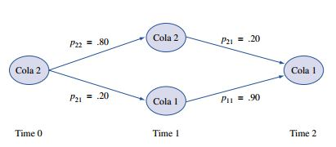
n-step Transitions Probability Examples(Cont..)
Pepsi vs Coke Example:
Pr[ Pepsi→?→Coke ] =
Pr[ Pepsi→Coke→Coke ] + Pr[ Pepsi→ Pepsi →Coke ] =
p₂₁p₁₁ + p₂₂p₂₁ = (.20)(.90) + (.80)(.20) = .34.

Slide 26
n-step Transitions Probability Examples(Cont..)
Pepsi vs Coke Example:
Given that a person is currently a Coke purchaser, what is the probability that he will purchase Pepsi three purchases from now?

Slide 27
n-step Transitions Probability Examples(Cont..)
Weather Example:
p₂₁(2) = P { Wednesday is sunny | Monday is rainy }
= p₂₁p₁₁ + p₂₂p₂₁
= (0.4)(0.7) + (0.6)(0.4)
= 0.52
0.7
0.3
0.6
sunny
rainy
0.4
State 1: Sunny State 2: Rainy

Slide 28

n-step Transitions Probability Examples(Cont..)
Gardener Problem Example:
Question: Find out the probability of the soil
condition of being Bad if it was Good after
two and three seasons of gardening.
Solution: Try it yourself.
State 1: Good State 2: Fair
State 3: Bad

Slide 29
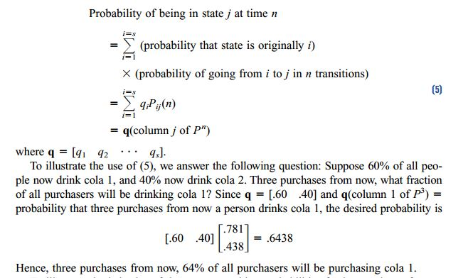
Unconditional State Probability
In many situations we do not know the state of the Markov chain at time 0.
let q_{i} be the probability that the chain is in state i at time 0. Then we can determine the probability that the system is in state i at time n by using the following reasoning:

Slide 30
Unconditional State Probability(Cont..)
q_{o} = [ 0.6, 0.4] is called the initial distribution
So what fraction of people will drink Pepsi three weeks from now?
P[X₃=Pepsi] = q_{o} * (2nd column of P³) = [0.6 0.4] * [0.219 0.562]^{T}
= 0.3562(That means 35%)

Slide 31


Unconditional State Probability(Cont..)
For Gardener Problem, if the initial condition of the soil is = (1, 0, 0)
Determine the absolute probabilities of the three states of the system after 1, 8 and 16 seasons.
q₁ ₌
q₈ =
Do the same for other seasons.

Slide 32
Classification of States in a Markov Chain
We know that probabilities associated with states.
We can classify the states of the system
whether we can transit from one state to another
whether you can return to a state
Path - a sequence of transitions from state i to state j exists and has positive probability, i.e., P_{ij}(n)>0 for some n.
State j is Reachable from state i if there is a path from i to j
Two states, i and j, Communicate (i ↔ j) with each other if j is reachable from i and i is reachable from j.

Slide 33
Classification of States in a Markov Chain(Cont..)
Here, State 5 is Reachable from state 3. But state 5 is not reachable from state 1. Also states 1 and 2 Communicate.
A set of states S in a Markov chain is a Closed set if no state outside of S is reachable from any state in S.
S₁ = {1, 2} and S₂ = {3,4, 5} are both closed sets. Once we enter a Closed set, we can never leave the Closed set.
.6
.7
.4
1
.5
2
.5
.3
3
4
.4
.5
.8
.1
5
S₁
.2
S₂

Slide 34
Classification of States in a Markov Chain(Cont..)
Irreducible Markov Chain – If there is only one closed set.
Eg: Weather, Coke vs Pepsi
A state i is an Absorbing state if the process never will leave the state.
The state returns to itself with certainty in one transition
P_{ij} = 1 (closed set with 1 member)
Eg: Gambler’s Ruin Problem: Both $0 and $4 are absorbing states

Slide 35
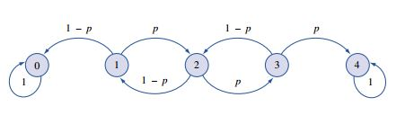
Classification of States in a Markov Chain(Cont..)
A state i is a Transient state if there exists a state j that is reachable from i, but the state i is not reachable from state j.
In other words, a state i is transient if there is a way to leave state i that never returns to state i.
In the gambler’s ruin example, states 1, 2, and 3 are Transient states. For example (see Figure) from state 2, it is possible to go along the path 2–3–4, but there is no way to return to state 2 from state 4.
Mathematically,

Slide 36
Classification of States in a Markov Chain(Cont..)
A state is Recurrent if upon entering the state, the process definitely will return the state again.
If and only if it is not transient.
For Gambler’s Ruin example, states 0 and 4 are recurrent states (and also absorbing states)
Questions:
Gardener Problem: State 1,2 – Transient or Recurrent?
Ans: Transient
Gardener Problem: State 3 – Absorbing.
.5
.2
1
2
.5
.3
.5
3
1

Slide 37
Classification of States in a Markov Chain(Cont..)
State i is Periodic with period k > 1 if k is the smallest number such that all paths leading from state i back to state i have a length which is a multiple of k.
A recurrent state that is not Periodic is called Aperiodic.
Eg:
.6
1
2
1
.6
.4
.4
3
Continuing with n = 6, 7, …., P^{n} shows that ^{P}₁₁ and ^{P}₃₃ are positive for even values of n and zero for others. So the period of state 1 and state 3 is 2.
State 2 is Aperiodic because it is recurrent.

Slide 38
Classification of States in a Markov Chain(Cont..)
If all states in a Markov Chain are recurrent, aperiodic, and communicate with one another, then the Markov Chain is said to Ergodic.
Eg:
Gambler Ruin:
Non-Ergodic
Weather:
Ergodic
Coke vs Pepsi:
Ergodic
Gardener:
Non-Ergodic

Slide 39

Classification of States in a Markov Chain(Cont..)
Matrix Examples:
^{P}₁ = $\left(\begin{matrix}1/3 & 2/3 & 0 \\ 1/2 & 0 & 1/2 \\ 0 & 1/4 & 3/4\end{matrix}\right)$ Ergodic
^{P}₂ = $\left(\begin{matrix}1/4 & 1/2 & 1/4 \\ 2/3 & 1/3 & 0 \\ 0 & 2/3 & 1/3\end{matrix}\right)$ Ergodic
^{P}₃ = $\left(\begin{matrix}1/2 & 1/2 & 0 & 0 \\ 1/2 & 1/2 & 0 & 0 \\ 0 & 0 & 2/3 & 1/3 \\ 0 & 0 & 1/4 & 3/4\end{matrix}\right)$ Non Ergodic

Slide 40
Long Run Property of Markov Chain(Steady State Probability)
n-step transition probabilities for Cola drinkers:
After a long time, a person’s next cola purchase probability doesn’t depend on whether s(he) was initially a Coke or Pepsi purchaser.
Steady state Probabilities are used to describe the long run behavior of a Markov chain.
So we can say the states after long run go to steady states.

Slide 41
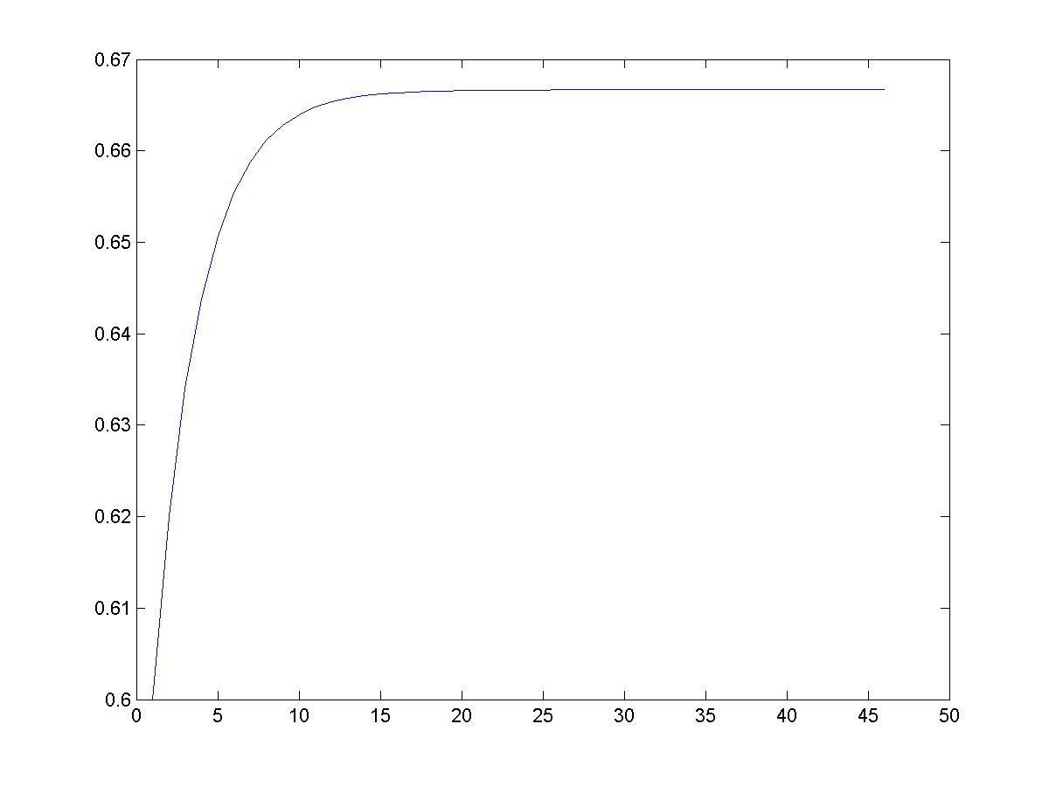
Long Run Property of Markov Chain(Steady State Probability)(Cont..)
Simulation:
2/3
Pr[X_{i} = Coke]
stationary distribution
0.9
0.1
0.8
coke
pepsi
0.2
week - i

Slide 42
Long Run Property of Markov Chain(Steady State Probability)(Cont..)
Steady State Probability Theorem: Let P be the transition matrix for a s-state ergodic chain, then there exists a vector π = [ ] such that
Recall that, ij-th element of P^{n} is P_{ij}(n). So the theorem tells that,
This means that after a long time, the Markov chain settles down, and (independent of the initial state i) there is a probability that we are in state j.

Slide 43
Long Run Property of Markov Chain(Steady State Probability)(Cont..)
π_{j} are called the steady state probabilities.
Vector π is called steady state/ equilibrium distribution.
Steady state:
doesn’t mean that the process settle down to one state.
Means - Prob. of process in state j, after long time, tends to π_{j} , and independent of initial state distribution.
How can we find steady state probability distribution?

Slide 44

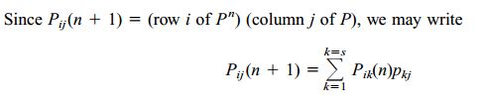

Long Run Property of Markov Chain(Steady State Probability)(Cont..)
From theorem, for large n and all i, ……… (1)
………….. (2)
If n is large, substituting (1) into (2) yields
In matrix form, …….. (3)
Unfortunately eqn. (3) has infinite no. of solutions.
To have unique solution, along with eqn (3), we use
That means,

Slide 45
Long Run Property of Markov Chain(Steady State Probability)(Cont..)
To illustrate steady state probability, let’s find the steady state probability of Coke vs Pepsi example:
Recall the transition matrix:
Solution:

Slide 46
Long Run Property of Markov Chain(Steady State Probability)(Cont..)
Suppose, 100 million cola customer, each person purchase 1 cola during any week. Each selling profits $1. For $500 million per year, an advertising firm guarantees to decrease 10% to 5% of Coke customers who switch to Pepsi after a purchase. Should Coke company hire the add firm?
Solution:
Total cola purchase in a year (52 week)
= 100* * 52= 52,00,000,000 or 5.2 billion
Each purchase earns $1 profit for a company

Slide 47

Long Run Property of Markov Chain(Steady State Probability)(Cont..)
Solution(Cont..) :
Current profit in a year for Coke company
= 2/3 (5.2 billion * $1) [ since steady state prob. of buying coke = 2/3]
= $3,466,666,667
What the add firm offers to Coke company is for $500 million per year
Then what will be the long run probability or steady state probability?
$$π_{1}$$

Slide 48
Long Run Property of Markov Chain(Steady State Probability)(Cont..)
Solution(Cont..) :
New profit in a year for Coke company will be
= 0.8 * (5.2 billion * $1) - $500 million
= $3,660,000,000
So, they should hire the add firm

Slide 49

Long Run Property of Markov Chain(Steady State Probability)(Cont..)
Gardener Problem with Fertilizer:
Solution:
Therefore, π = [.1017 .5254 .3729]

Slide 50
Long Run Property of Markov Chain(Steady State Probability)(Cont..)
What this probability say is that, in the long run, the soil condition approximately will be good 10% of the time, fair 52% of the time and poor 37% of the time.
Suppose the cost of the fertilizer is $50 per bag and the garden needs two bags if the soil is good. The amount of fertilizer is increased by 25% if the soil is fair and 60% if the soil is poor. The gardener estimates the annual yield to be worth $250 if no fertilizer is used and $420 if fertilizer is applied. Is it worthwhile to use the fertilizer?
Solution:
From previous case,
π = [.1017 .5254 .3729]

Slide 51
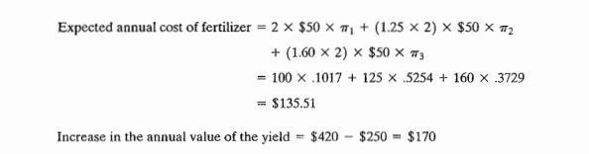
Long Run Property of Markov Chain(Steady State Probability)(Cont..)
Solution(Cont..):
The result shows that on the average, the use of fertilizer nets $170 – $135.51 = $34.49. Hence, the use of fertilizer is recommended.

Slide 52


Mean First Passage Times
For an ergodic chain, let m_{ij} = expected number of transitions before we first reach state j, given that we are currently in state i
m_{ij} is called the mean first passage time from state i to state j.
Assume that we are currently in state i. Then with probability p_{ij}, it will take one transition to go from state i to state j. (Case 1)
For k ≠ j, we next go with probability p_{ik} to state k. In this case, it will take an average of 1 + m_{kj} transitions to go from i and j. (Case 2)
This reasoning implies:
since

Slide 53
Mean First Passage Times(Cont..)
By solving the linear equations of the equation above, we find all the mean first passage times.
It can be shown that mean recurrence time (for steady state case)
For the cola example, π₁=2/3 and π₂ = 1/3
Hence, m₁₁ = 1.5 and m₂₂ = 3
m₁₂ = 1 + p₁₁m₁₂ = 1 + .9m₁₂
m₂₁ = 1 + p₂₂m₂₁ = 1 + .8m₂₁
Solving these two equations yields, m₁₂ = 10 and m₂₁ = 5
m₂₁ = 5 means a person who last purchased Pepsi, s(he) will purchase Pepsi on average 5 times before he move to Coke.

Slide 54
Problems
Winston book:
Example 1, 2, Page: 927(Problem: 1, 3, 4), Example 4, Page: 931(Problem: Group A), Page: 934(Problem: 3, 4, 6), Example 5, Page: 940-941(Problem: 1, 2, 3, 4, 7, 12)
Taha book:
Example 17.1-3, Problem Set 17.1A(2, 4), Example 17.2-1, Problem Set 17.2A(4), Example 17.3-2, Problem Set 17.3A(1), Example 17.4-1, 17.4-2, Problem Set 17.4A(1, 3, 8, 11)
Read the slide topics + maths

Slide 55
References
Operations Research Applications and Algorithms(4th Edition) – Wayne L. Winston
Operations Research, An Introduction(8th Edition) – Hamdy A. Taha

Slide 56


